Slide 1

CMR COLLEGE OF ENGINEERING & TECHNOLOGY
Kandlakoya, Medchal, Hyderabad - 501401
Department of Computer Science and Engineering
Library Management System
Name of the student
Om Gupta
P.Geeta Madhuri
Rohan Sachin Rakhe
Under esteemed guidance of
Guide Name
Ms.M.N.Sailaja, Assistant Professor

Slide 2
Outline
Abstract
Introduction
Literature survey
Existed system
- Problems in existed system
Research Objective of Presentation
Problem Definition
Research work
- Proposed system architecture
- Methods
- Comparison of Proposed system with an existed system
Performance Measure
Results
Conclusion
Future Work
Notes:
2

Slide 3
Abstract
To create an application for the purpose of efficient and effective Library Management System for registered students. Library Management System is customizable and user configurable. This project is an effort to develop an efficient and user friendly application in regards to Library management. The system employs Tkinter for its graphical user interface(GUI) and relies on MySQL for secure data storage. This combination enhances Library Operations simplifying tasks, improving data management, and increasing overall accessibility. In this we try to maintain the record of books in library. It will track on how many books are available and issued. As we know that for issuing books, students have to go to the Main library and then find the books they wish to borrow. Although having separate compartments for similar kind of books based on department and genres, the process of browsing through the large shelfs in the physical library could be cumbersome. In order to resolve all these problems, we decided to create this project. To maintain the records related to availability of books and addition of books. As it is computerized so Book issue will be faster and it is also easy to keep track of every book issued.
Notes:
3

Slide 4
INTRODUCTION
Library management is an essential task for any educational institution that aims to provide a conducive learning environment for its students. A library management system (LMS) is a software application that helps to organize, maintain, and track the books and other resources in a library. An LMS can also facilitate the borrowing and returning of books, as well as the management of users and their accounts.
The purpose of this project is to create an LMS that is efficient, effective, and customizable for the registered students of a specific institution. The LMS will allow the students to search, reserve, and borrow books from the library, as well as to view their borrowing history and due dates. The LMS will also enable the librarians to manage the inventory of books, as well as to monitor the status and availability of each book. The LMS will be user configurable, meaning that the librarians can adjust the settings and preferences of the system according to their needs and preferences.
Notes:
4

Slide 5
Literature Survey
Design and Implementation of a Library Management System Based on the Web Service: This paper proposes a library management system that uses a three-layer architecture, UML, JSP, and SQL Server 2005 technologies. The system also includes a guest book sub module to provide feedback for the users. The paper claims that the system improves the operating efficiency and performance of the database.
Research on The Framework of Library Management System Based on Internet of Things: This paper designs the information infrastructure and key mechanism of a library management system that uses RFID technology as the core. The system also integrates SAAS and cloud computing platform to provide intelligent and innovative services for the users. The paper reports that the system has good information acquisition ability and meets the needs of the readers.
Designing Web-based Library Management System: This paper designs a web-based library management system that aims to solve the problems encountered in the manual library. The system uses PHP, MySQL, HTML, CSS, and JavaScript technologies. The paper states that the system provides a user-friendly and secure interface for the users.
Notes:
5

Slide 6
EXISTED SYSTEM
One of the existing systems that I improved upon is the web-based library management system designed by [Khan et al.]. Their system aims to solve the problems encountered in the manual library, such as low efficiency, high error rate, and poor security. Their system uses PHP, MySQL, HTML, CSS, and JavaScript technologies to provide a user-friendly and secure interface for the users. However, their system has some limitations and drawbacks, such as:
The system does not support the reservation and cancellation of books, which can cause inconvenience and confusion for the users who want to borrow or return books.
The system does not provide any feedback or notification mechanism for the users, such as email or SMS alerts, which can help them to keep track of their borrowing status and due dates.
The system does not have any book recommendation or rating system, which can enhance the user satisfaction and engagement with the library resources.
The system does not have any backup or recovery mechanism, which can jeopardize the data integrity and reliability of the system in case of any failure or disaster.
Notes:
6

Slide 7
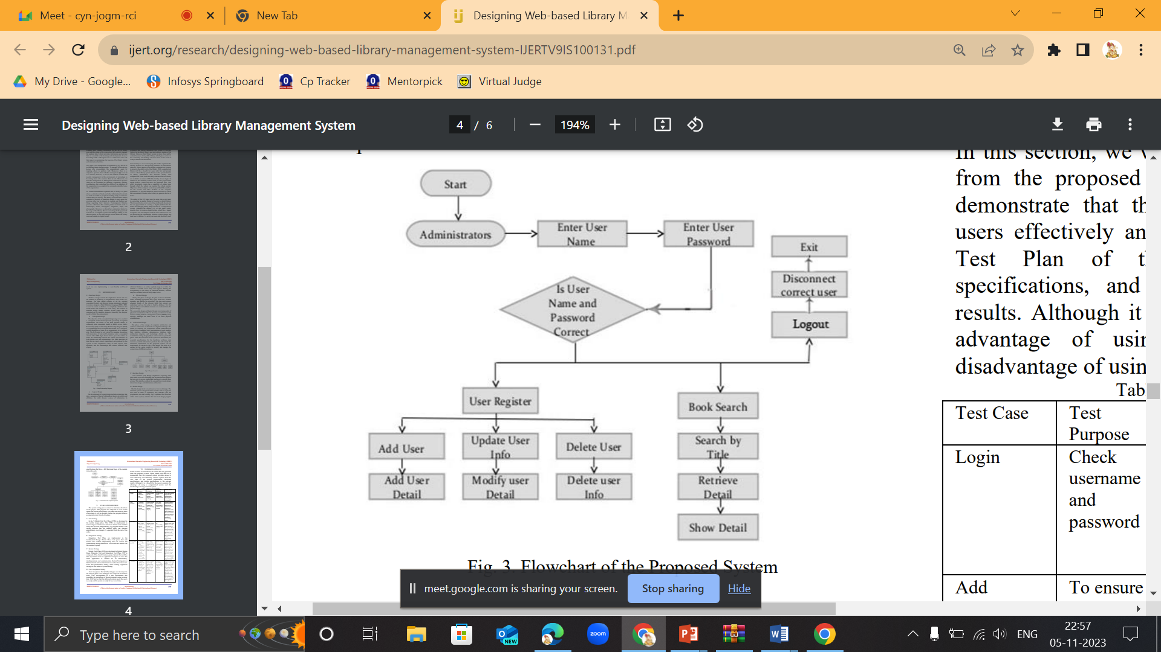

Slide 8
Research objective
The main goal of this project is to create a highly efficient and user-friendly Library Management System that is customized for the registered students of a specific institution. The system, which uses Tkinter as the graphical user interface (GUI) framework and MySQL as the database management system, aims to simplify and improve the library operations, such as book search, reservation, borrowing, returning, and account management. This research tries to solve the problems and challenges that the students face when they want to access the books from the physical library, such as low efficiency, high error rate, and poor accessibility. By implementing a digital solution, the system can help the students to find and borrow the books they need easily and quickly. Additionally, the project aims to keep accurate and updated records of the book availability and additions in the library, with the ultimate goal of speeding up the book issuing process and ensuring comprehensive tracking of all the books that are issued.

Slide 9
Problem Definition
It is a common practice that students have to go to the Main library and search for the books they are interested in borrowing. However, this can be a time-consuming and exhausting process, as the books are arranged by department and genres in separate sections, but the shelfs are still large and crowded. To address these issues, we embarked on this project.

Slide 10
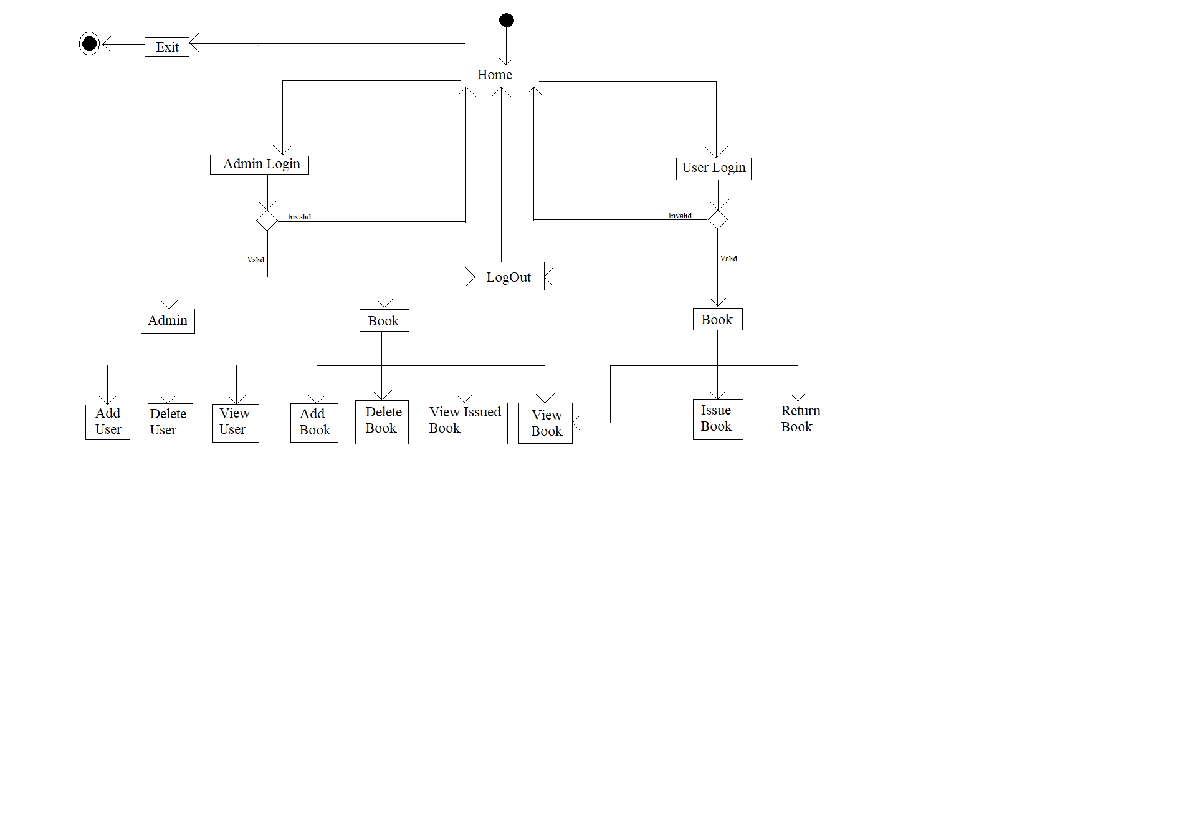
Research Work
Proposed system architecture
Notes:
10

Slide 11
Proposed Methods
The proposed methodology of my project consists of the following steps:
Requirement Analysis: Gather detailed requirements for the Library Management System application through stakeholder discussions and operational study.
Design Phase: Design user interface using Tkinter for customization and MySQL for secure data storage.
Development: Implement frontend and backend logic, integrate with MySQL database.
Functionality Implementation: Add, edit, and delete book records, manage user authentication, enable book check-in/check-out, and track transactions.
Testing: Conduct comprehensive testing for functionality, user interface, and database integrity.
Deployment: Prepare and deploy the application on the designated server.
Training and Documentation: Provide training to users and create user documentation for reference.
User Acceptance Testing (UAT): Allow a selected group of users to perform final testing and gather feedback.
Feedback and Iteration: Incorporate user feedback and make necessary adjustments.
Implementation and Maintenance: Deploy the final version, monitor performance, and conduct regular updates and maintenance.

Slide 12
Performance Measure
The performance measure for our project is a way to evaluate how well our application meets the requirements and expectations of the library system. We can use various criteria and metrics to measure the performance of our project, such as:
Functionality: This criterion assesses whether our application performs all the functions that are specified in the project scope, such as adding, deleting, viewing, issuing, and returning books and users. We can use metrics such as the number of functions implemented, the accuracy of the functions, the error rate of the functions, etc.
Usability: This criterion evaluates how easy and user-friendly our application is for the library staff and the users. We can use metrics such as the user satisfaction, the user feedback, the user interface design, the user interaction, the user documentation, etc.
Efficiency: This criterion measures how fast and reliable our application is for the library operations. We can use metrics such as the response time, the throughput, the resource utilization, the scalability, the reliability, etc.
Security: This criterion examines how secure and authenticated our application is for the library resources and the user data. We can use metrics such as the encryption, the authentication, the authorization, the access control, the audit trail, etc.
Flexibility: This criterion checks how flexible and configurable our application is for the library services and policies. We can use metrics such as the customization, the adaptability, the modifiability, the maintainability, etc.

Slide 13
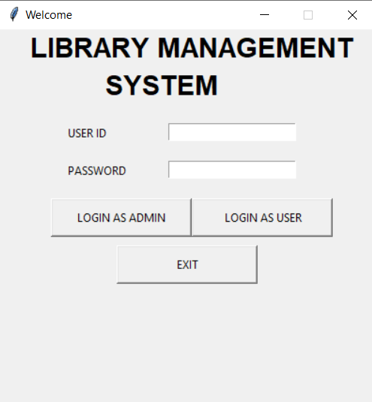
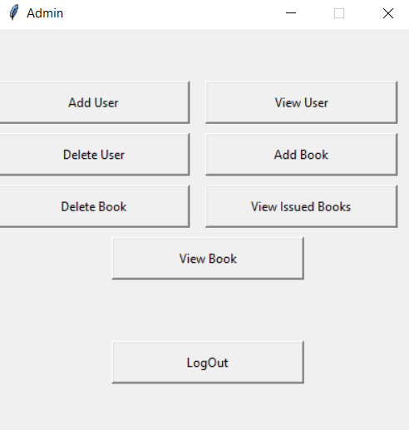
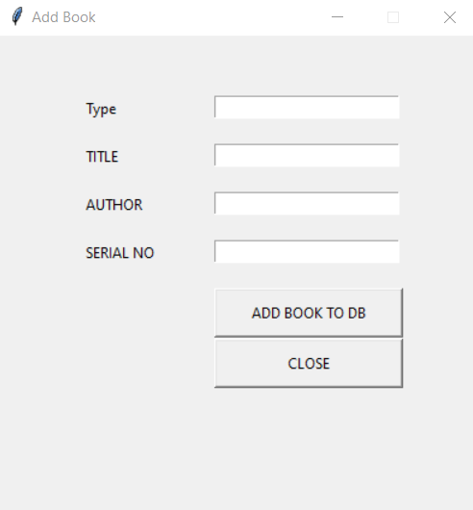
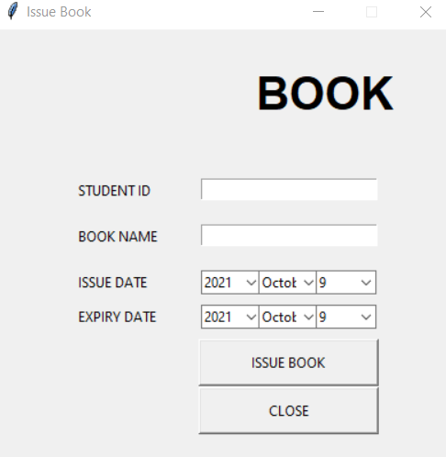
Result Analysis

Slide 14
Conclusion
It overcomes all the disadvantages of the manual system, and it reduces the manual work partially.
We have successfully completed the Library Management System project. Here are the files we have created and the functions they perform:
Adduser: This file allows the library staff to add new users to the system.
Deleteuser: This file allows the library staff to delete existing users from the system.
Viewusers: This file allows the library staff to view the total number of users in the system.
Addbook: This file allows the library staff to add new books to the library database.
Deletebook: This file allows the library staff to delete existing books from the library database.
Viewbook: This file allows the library staff and the users to view the books available in the library.
Issuebook: This file allows the library staff to issue books to the users.
Returnbook: This file allows the library staff to return books from the users.
Home: This file displays the home page of the system, which shows all the functions available.

Slide 15
Future work
The project has achieved its main objectives and delivered a functional and user-friendly library management system for the registered students. However, there are still some areas that can be improved and enhanced in the future. Some of the future work for this project are:
Adding more features and services for the users, such as book recommendation, book rating, book review, book sharing, and book club.
Improving the security and privacy of the system, such as encrypting the data, implementing the backup and recovery mechanisms, and adding the role-based access control for the users and the librarians.
Improving the performance and scalability of the system, such as optimizing the code, using the caching and indexing techniques, and deploying the system on the cloud platform.
Improving the user interface and user experience of the system, such as adding the animations, sounds, and notifications, and conducting the user testing and feedback sessions.

Slide 16
References
Design and Implementation of a Library Management System Based on the Web Service. (n.d.). Design and Implementation of a Library Management System Based on the Web Service | IEEE Conference Publication | IEEE Xplore. https://ieeexplore.ieee.org/document/6405716/
Research on The Framework of Library Management System Based on Internet of Things. (n.d.). Research on the Framework of Library Management System Based on Internet of Things | IEEE Conference Publication | IEEE Xplore. https://ieeexplore.ieee.org/document/9410108
Araya, T. W., & Mengsteab, A. (2020, October 18). Designing Web-based Library Management System – IJERT. Designing Web-based Library Management System – IJERT. https://doi.org/10.17577/IJERTV9IS100131

Slide 17
Thank You!

